Slide 1
Historical monuments of Prešov
a project of Marek Kačmár and Martin Kažimír

Slide 2
Calvary
set up since 1721 until 1893
the whole complex is the Church of the Holy Cross , fourteen chapels of the Cross, Chapel of the Holy Steps, Catacombs and cemetery.
church of the Holy Cross was built in Calvary in 1753

Slide 3
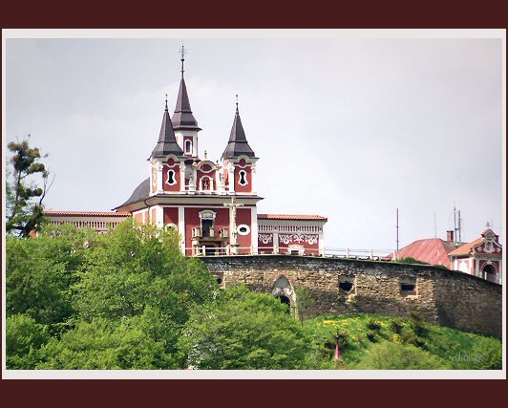
Calvary complex

Slide 4
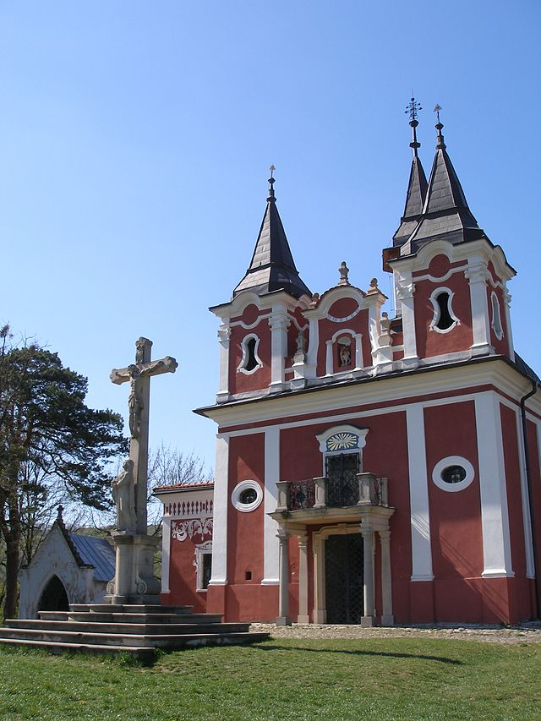
The Church of the Holy Cross
One of the fourteen chapels

Slide 5
Michal Bosak
*10. december 1869, Okrúhle
† 18. february 1937, Scranton, Pennsylvania USA
in 1886 he went to the USA, he worked as a miner in Hazleton
in 1897 he founded a private bank Michael Bosak Privat Bank
in 1915 he founded his own bank Bosak State Bank in Scranton, the Bank has become the largest Slovak bank in the United States
in 1920 was established in Bratislava Slovak -American Bank

Slide 6
Bosak’s Bank
was built in 1923
the name was given after Michal Bosak
built in Nouveau style
even today it is one of the most beautiful buildings in the city.

Slide 7
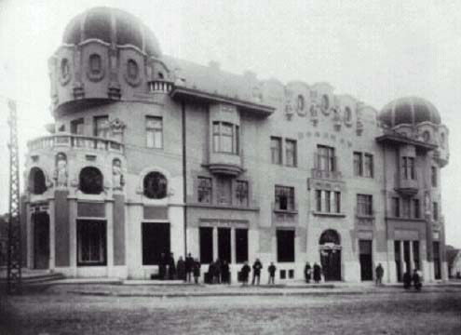
Bosak’s Bank in 1925 and now

Slide 8
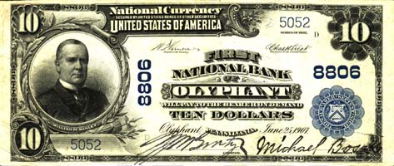
Interior of the bank
American tenner from 1907

Slide 9
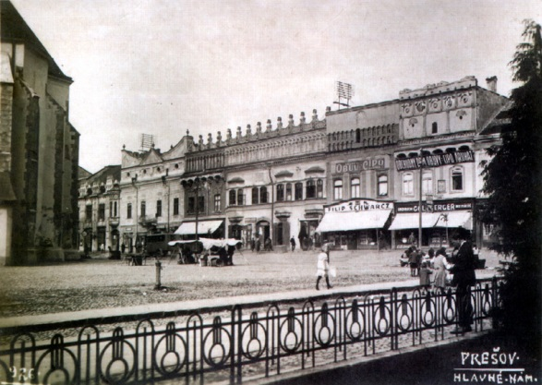
Rakoczi’s palace
originally consisted of 2 medieval houses
bought by Žigmund Rakoczi
in 1633 Prešov peace was signed
in 1711 palace is confiscated

Slide 10
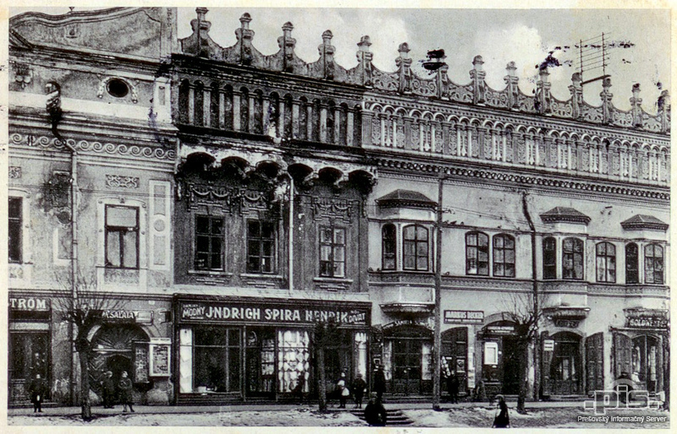
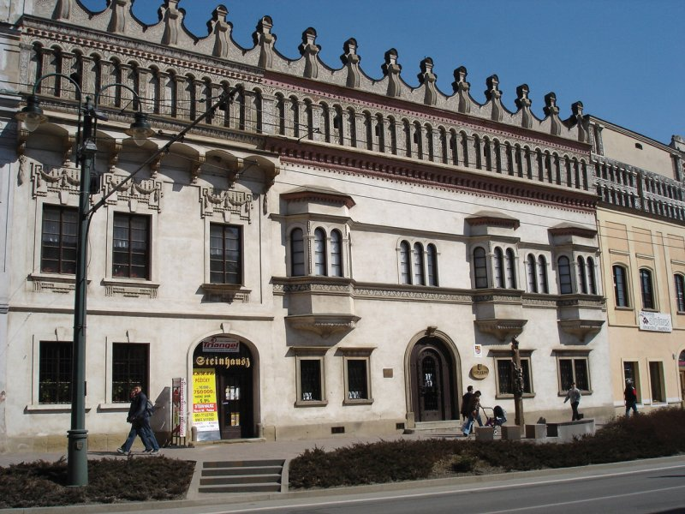
Rakoczi’s palace before and now

Slide 11
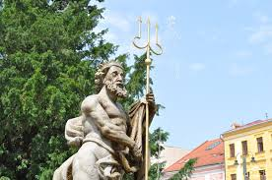
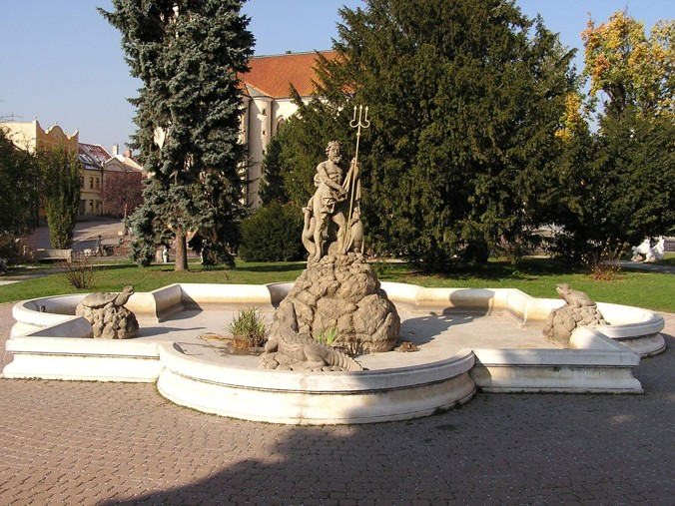
Neptun’s fountain
built by Mark Holländer in early 19s
was allowed to stay in Prešov because of good relationship with monarch

Slide 12
Greek-Catholic temple of the saint Ján Krstiteľ
in 14th century was built small chapel as part of the hospital
after reformation it became Evangelic
in 1753-1754 redeveloped and expanded
visit of the pope Ján Pavol II. in 1995

Slide 13
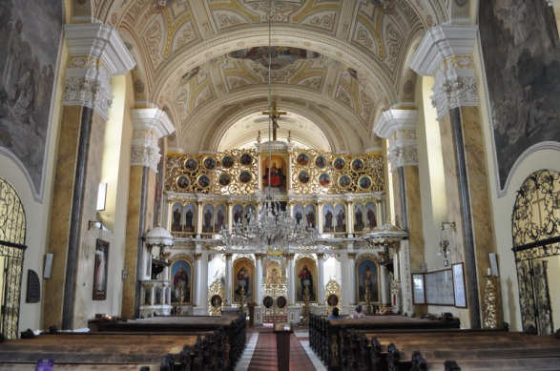
the outside and inside of the temple

Slide 14
Thank you for your attention !

